Slide 1
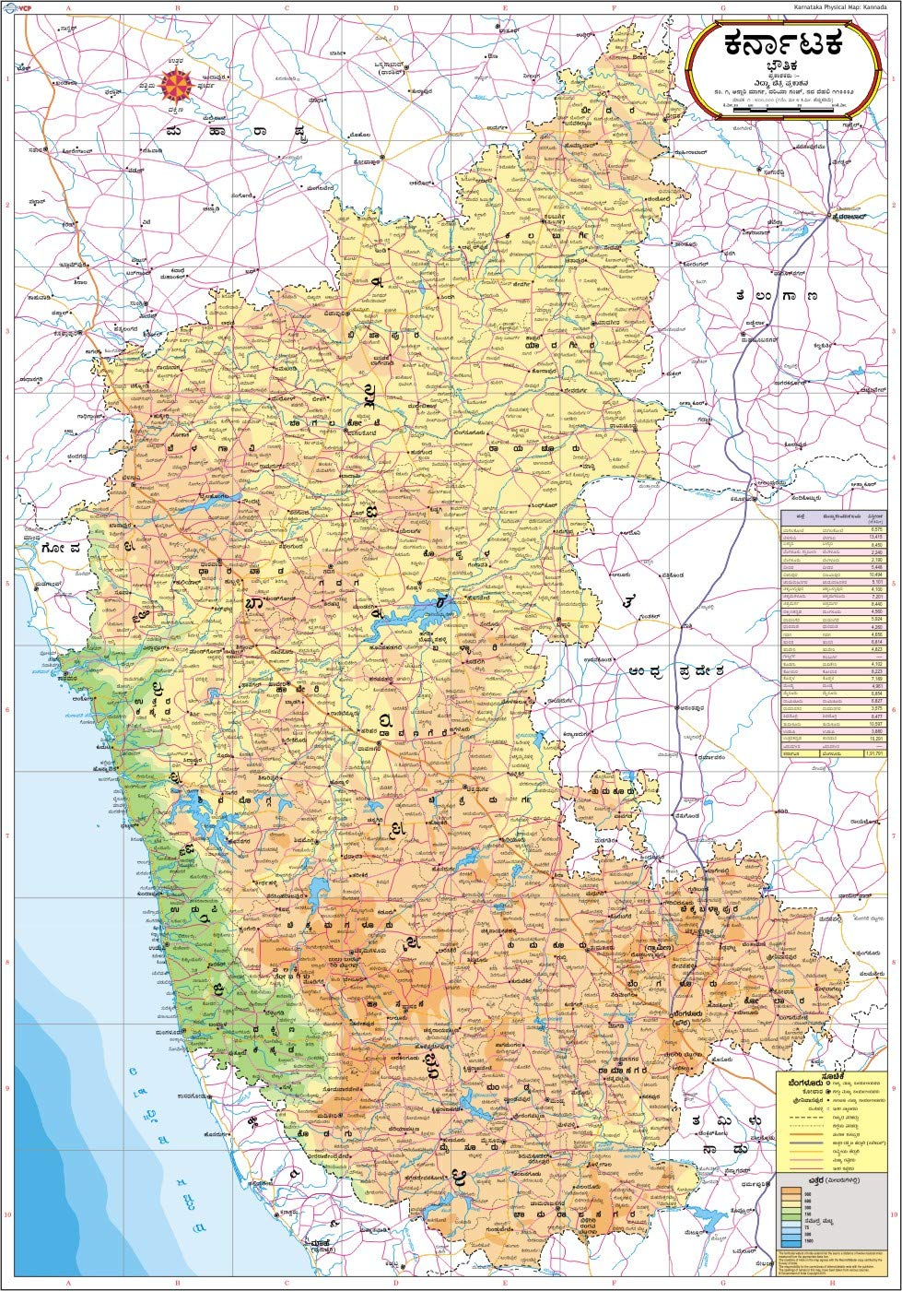
A Social Network Analysis of Rural Indian Villages
Anastasia Kvasha
Gyorgy Attila Ruzicska
Salma Taoufiq

Slide 2
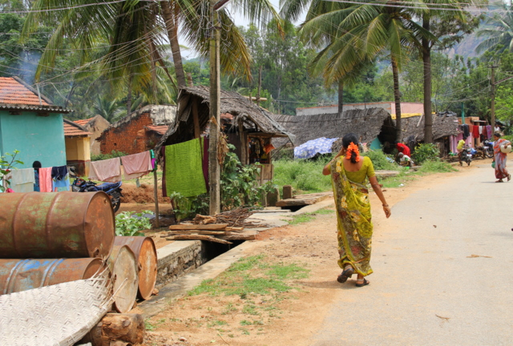
Background and Motivation
What characteristics determine whether an individual in a village is “strong tied” vs. “weak tied”?
How does a villager’s centrality relate to his/her level of “tiedness” ?
To what extent does Granovetter’s hypothesis hold in these villages? Why?
Notes:
the stronger the tie between two individuals, the bigger the fraction of common friends they have
Perceived centrality vs actual centrality

Slide 3
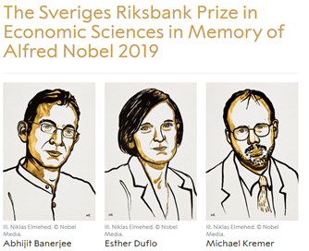
Data Source
Social Networks and Microfinance
An NSF-Funded Project Led By Abhijit Banerjee,
Arun G. Chandrasekhar, Esther Duflo and Matthew Jackson.
Data on social networks in 75 villages in rural southern India.
A census of households was conducted, and a subset of individuals was asked detailed questions about the relationships they had with others in the village. This information was used to create network graphs for each village. Basic information for all households and all surveyed individuals was also provided.
Several papers have made use of the rich network data, including theoretical work, econometric work, and lab experiments in the field that shed light on the role of networks on behavior.
Notes:
The Sveriges Riksbank Prize in Economic Sciences in Memory of Alfred Nobel 2019 was awarded jointly to Abhijit Banerjee, Esther Duflo and Michael Kremer "for their experimental approach to alleviating global poverty."

Slide 4
Data Description
Household characteristics:
religion;
caste / subcaste;
roof type;
number of rooms;
number of beds;
electricity;
latrine;
house ownership / rent;
whether one of the village leaders is living in the household.
Individual characteristics:
gender;
status;
age;
religion;
caste / subcaste;
mother tongue and knowledge of other languages;
education;
whether a person is a village native;
how long a person lived in a village;
occupation;
savings;
election card;
ration card.

Slide 5
Data Description
12 different types of interactions:
whose houses he or she visits;
who visits his or her house;
his or her relatives in the village;
non-relatives who socialize with him or her;
who gives him or her medical help;
from whom he or she borrows money;
to whom he or she lends money;
from whom he or she borrows material goods (e.g., kerosene, rice);
to whom he or she lends material goods;
from whom he or she gets important advice;
to whom he or she gives advice;
with whom he or she goes to pray (e.g., at a temple, church or mosque).

Slide 6
Descriptive statistics
16 912 individuals (nodes) in total (across 75 villages).
96% of all ties within the same households reached a weight of 12.
15% of individuals live in household where there is a leader
On average people have 6 strong ties and 10 weak ties
95% hindu, 5% islam
56% other backward caste (OBC) caste, 25% scheduled caste, 12% general
74% Kannada, 17% Telugu as mother tongue
90% owns a house, 65% has private electricity

Slide 7
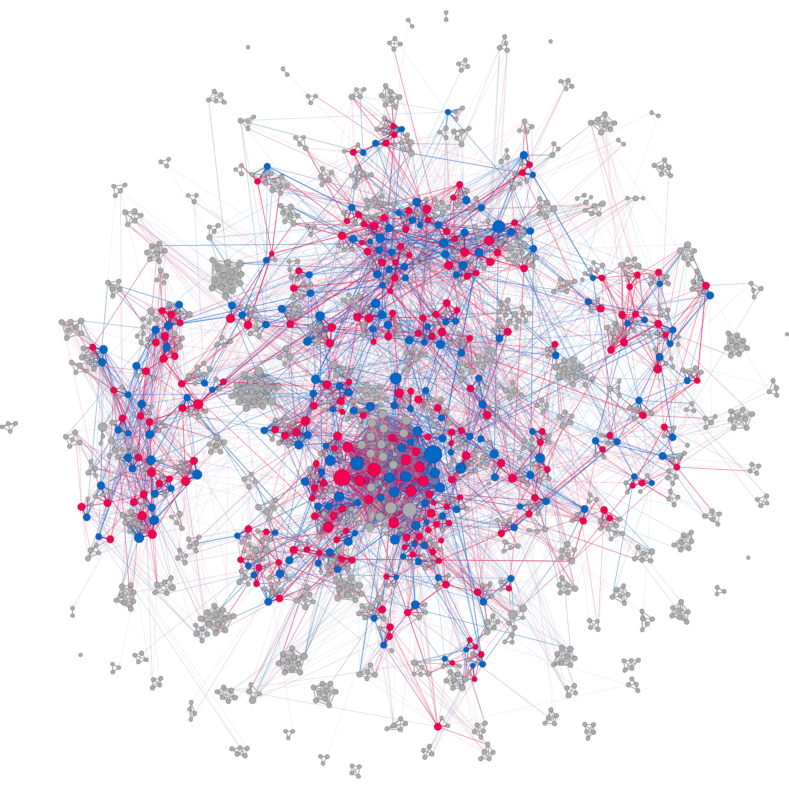
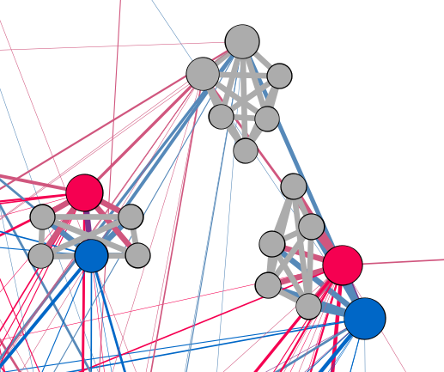
Aggregated network for village 52
(individuals)
Size of nodes shows degree
Blue nodes - males, red - females, grey - no data
Notes:
Village 52. 1525 individuals. 327 households.

Slide 8
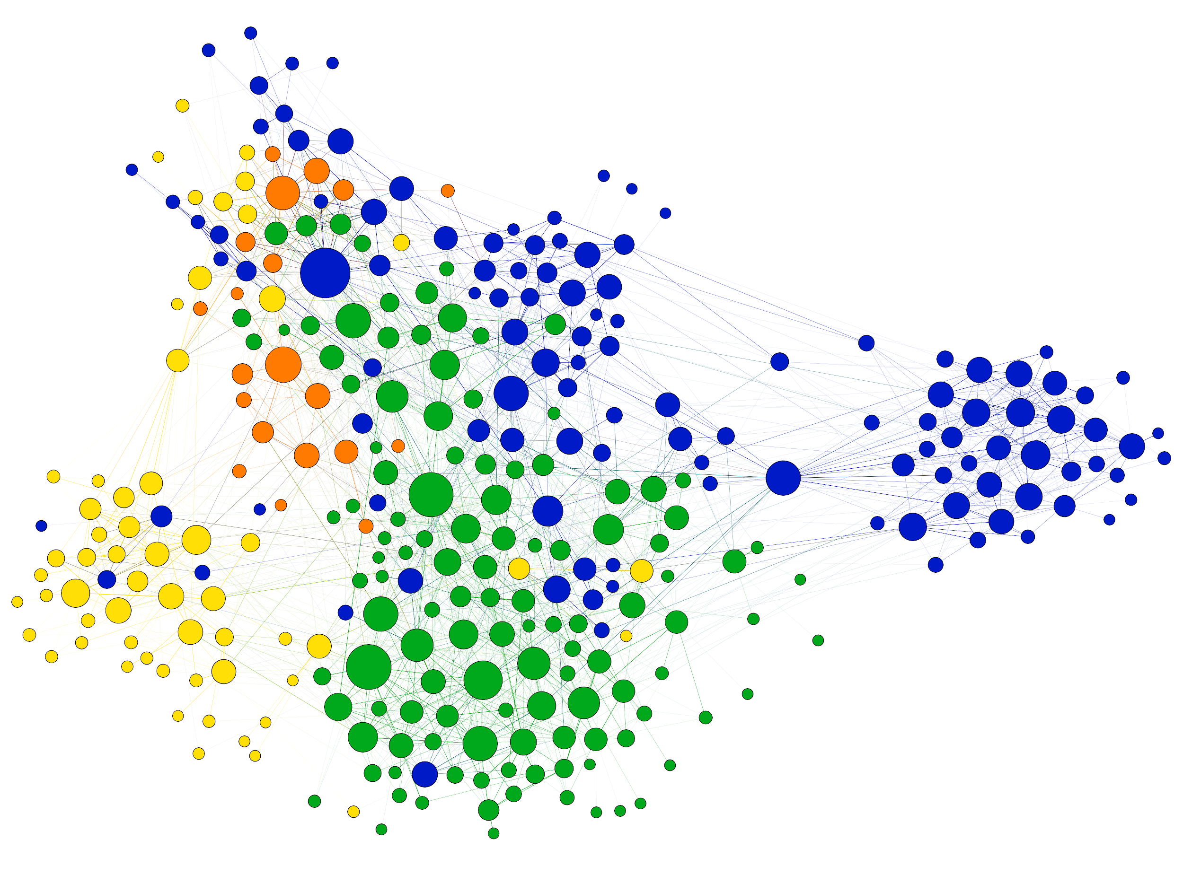
Aggregated network for village 52
(households)
Colors show different castes:
green - General Category (GC);
blue - Other Backward Caste (OBC);
yellow - Scheduled Caste (SC);
orange - Scheduled Tribe (ST).

Slide 9
Determinants of Individual “Tiedness”
What is “tiedness”?
A relationship between two people is considered to be “strong tied” if more than six layers are present.
We came up with three measures to calculate the strength of an individual’s relationship:
An individual is “strongly tied” if (s)he has more strong than weak ties.
The ratio of strong and weak ties.
The ratio of the actual number of layers and maximum number of layers for a person’s relations.

Slide 10
Regression Specifications
Tiedness measure = β0 + β1 *betweenness_c + β2 *closeness_c + βj *degree_cj
+ β4* gender + β5 *age + β6 * educ + β7 *native + β8 * work + β9*shg_participate
+ β10 * savings + β11 * election_card + β12 *ration_card + β13 * head_of_hh+
β13 * spouse_of_head_of_hh + …
Other dummies include: religion, caste, mother tongue and several household related measures
for j=1,2,...,12

Slide 11
“Tiedness” - Network Structure
More central villagers are expected to have more connections that can be deemed as weak, thus making their “tiedness” low.
High betweenness centrality ------ weakly tied, since these nodes have the most control over the flow of information between others and if removed from the network they will disrupt communications between remaining villagers the most due to their strategic position on the largest number of paths taken by messages.
Notes:
Low closeness centrality means high number of hops that must be taken in order to connect to the other distant nodes in the network.

Slide 12
“Tiedness” - Degree Centrality Across Layers
Here, a detailed exploration across all 12 layers was made.
General trend: High degree centrality ----- strong tiedness.
The higher the number of people a villager gives/takes advice from, borrows/lends money to, and attends the same religious temple with, the more strongly tied they are.
These types of relationships are based on trust.

Slide 13
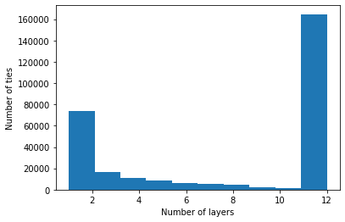
“Tiedness” - Degree Centrality Across Layers
Approx. 46% of all ties have a maximum strength of 12.
Families and people under the same roof usually know and trust each other, and thus rely on each other first. Therefore, the higher the degree centrality across the “Nonrelated” layer, the weaker one’s tiedness is.
Notes:
“Nonrelated” is equivalent to “engaging socially”, this majoritarily involves acquaintances and weak ties, like village shop workers with whom a villager interacts at each transaction for instance, or a neighbor with whom they are not necessarily close but exchange some niceties.

Slide 14
“Tiedness” - Individual Characteristics
Age:
As people age ------ tiedness increases.
Native of the village:
All three tiedness-related dependent variables are affected negatively by the “VillageNative” variable.
Village natives experience life in that village from the start, they “socialize” and interact with more people within the village than someone who was born and lived elsewhere before moving -> they make more acquaintances, potentially old friends from different walks of life.
Notes:
Age: As a person advances through their life, they tend to form strong bonds, making close friends, etc.

Slide 15
Education:
More educated -> weaker tiedness
According to India’s ASER Centre’s 2018 report: “Annual Status of Education Report (Rural) 2018”, an astonishing transformation has occurred in education in rural India within one generation.
Usually, the youth leave the village to continue their studies, pursue better careers, and this explains why the more-educated bunch end up having a higher number of weak ties within the village.
Notes:
Back in 2001, only roughly 25% of all 18-year-olds in rural India were attending school, as the rest have dropped out by that age. By 2016, the number of 18-year-olds attending schools and colleges had risen by up to 70%

Slide 16
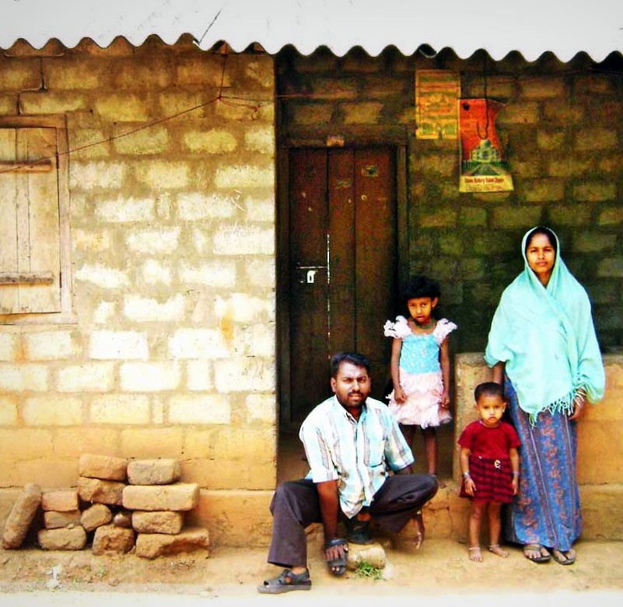
Responsibility :
“Head of household” -> weakly tied
Responsibility for the well-being of their home and the people within it -> work hard to provide -> set a certain routine caring for the same neighboring nodes -> thus establishing stronger links with only those while establishing a high number of weak ties due to the daily interactions needed to provide for their families: at work, in shops, etc.

Slide 17
The Determinants of the Strength of Granovetter’s Principle
The stronger the tie between two individuals, the bigger the fraction of common friends they have.
The Granovetter-based variable was computed based on the correlation between an individual’s tie strength and its neighbours overlap.
Temple_Company - positive, high-magnitude effect
Related / NonRelated - negative
Closeness centrality - negative
Betweenness centrality - positive
Notes:
We may summarize Granovetter’s hypothesis as follows. This Granovetter-based score, if high for a certain individual, expresses the fact that (s)he forms strong bonds with the people closest to them -i.e. those who they have multiple common friends with- and weak ones with those they are socially distant from. In contrast, if this score is low, it means that the person forms strong ties even with those who are distant from them socially.

Slide 18
Granovetter Correlation
Going to the same temple:
For people attending the same temple there is a higher chance that they would be connecting to the same circles and thus having a lot of common friends. Religion dominates all aspects of Indian rural life, it is really hard to discern any aspect of life that is not determined and permeated with religious rituals.
“Related” and “NonRelated”:
Negative coefficients meaning that those who socialize more actively not only form their strong ties with whom their neighbourhood overlap is large, but also with people outside their own circles. Furthermore, those who belong to a larger family form bonds more actively with socially distant individuals.

Slide 19
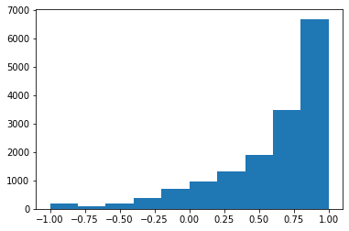
Granovetter correlation scores for individuals

Slide 20
Thank you!

